Slide 1
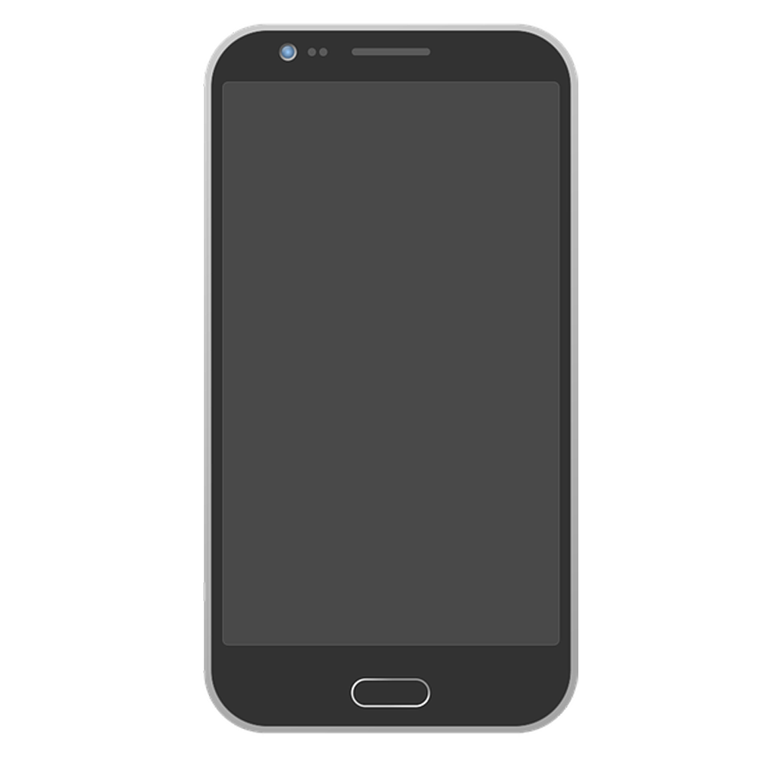
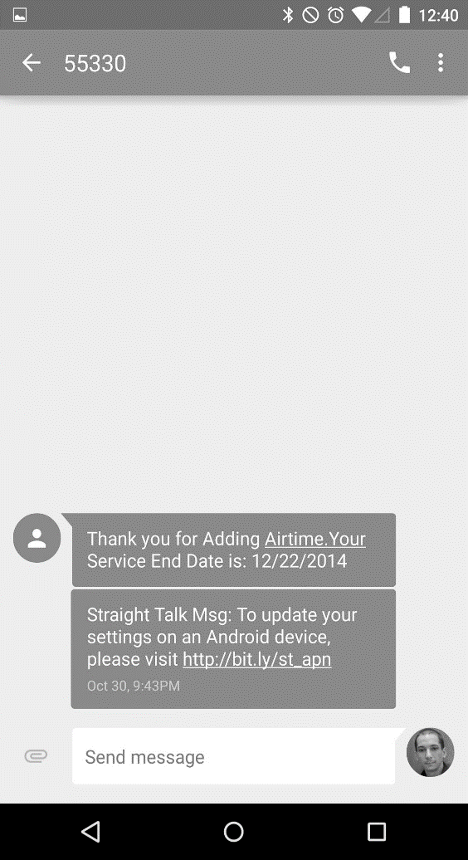
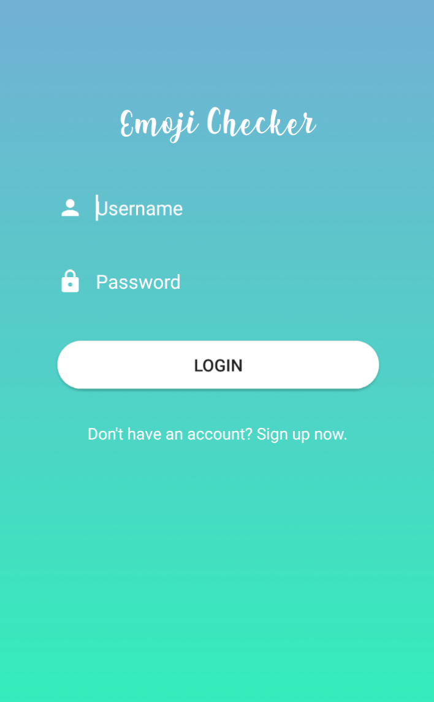
Emoji Checker
TEAM EMOJENIUS
Avneet Sethi, Riyan Imam,
Michael Wheeler, Jocelyn Lopez,
Storm Simpson

Slide 2

The Emoji Checker App
Product:
Records and log students’ feelings towards the current lecture through a seamless user interface
Allows students to view their previous responses/emojis to better prepare for their courses/upcoming tests
Value + Uniqueness:
Serves as a data analysis tool for professors to enhance the students’ learning experience by changing the classroom setting
Keeps students engaged
Target Audience:
Students and Professors

Slide 3
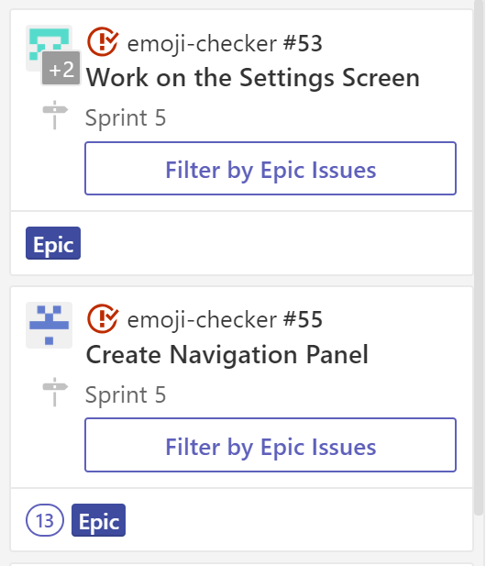
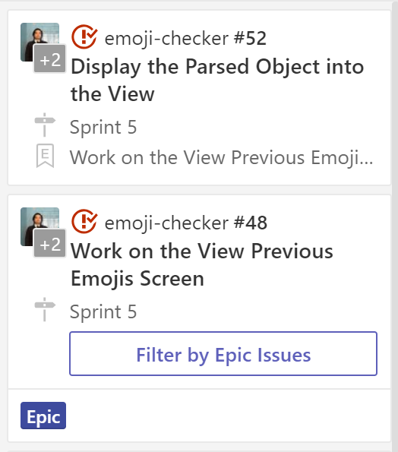
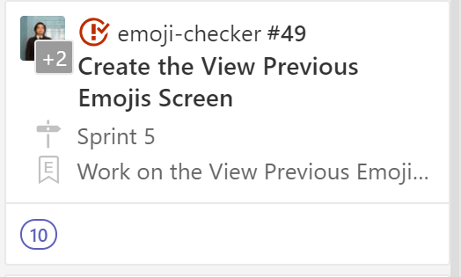
The Final Story
Completed Story Cards
Allow users to select an emoji from the Query Screen
Parse information such as emoji name and timestamp from the database to view previous responses
Enable change password functionality on Account Settings
Create a navigation panel to connect all of the screens

Slide 4
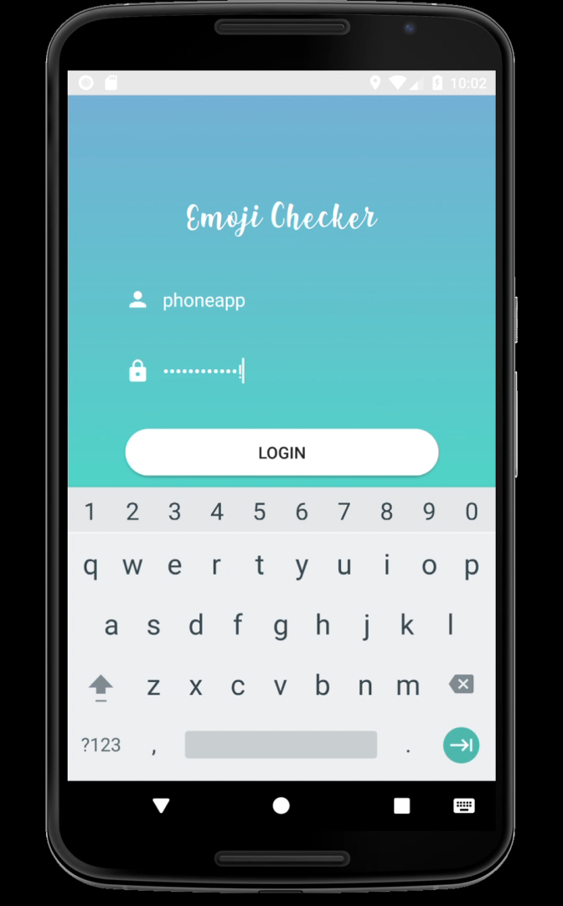
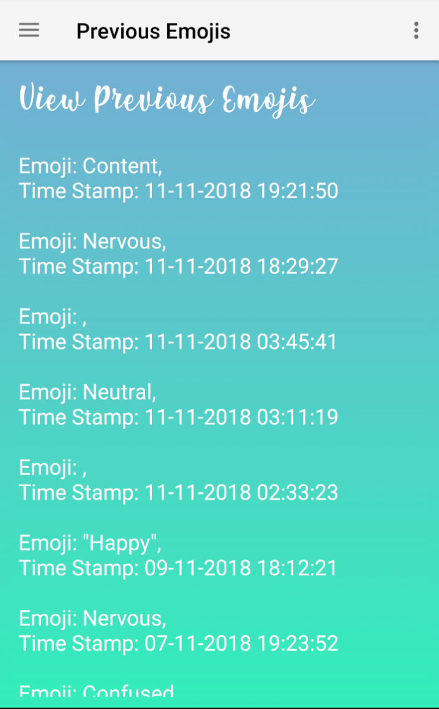
The Final Story
We can now select specific users from the endpoint that can send an emoji to the server within a 10 minute window. Users can now view their last 10 responses on the Previous Emojis screen. They can also change their password through the Account Settings tab.

Slide 5
Conceptual Models

Slide 6
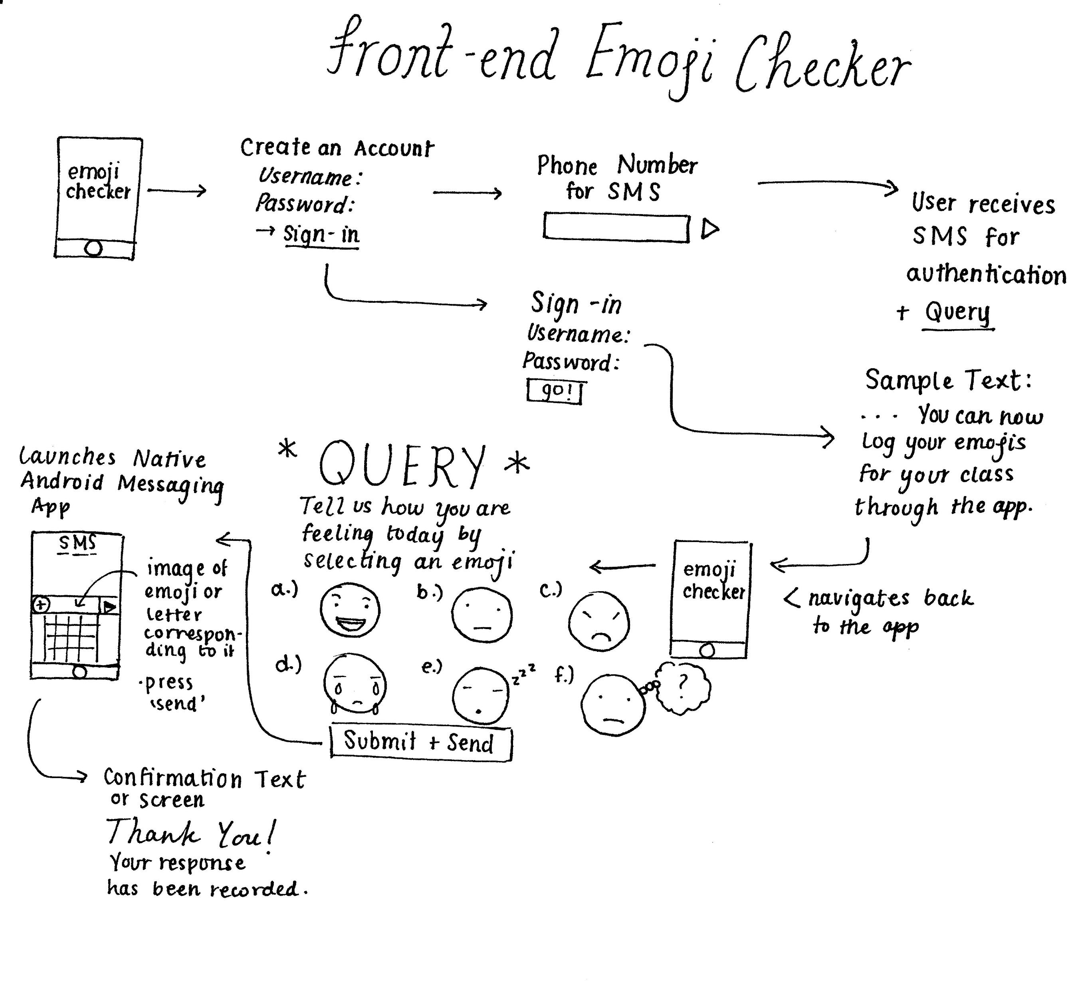
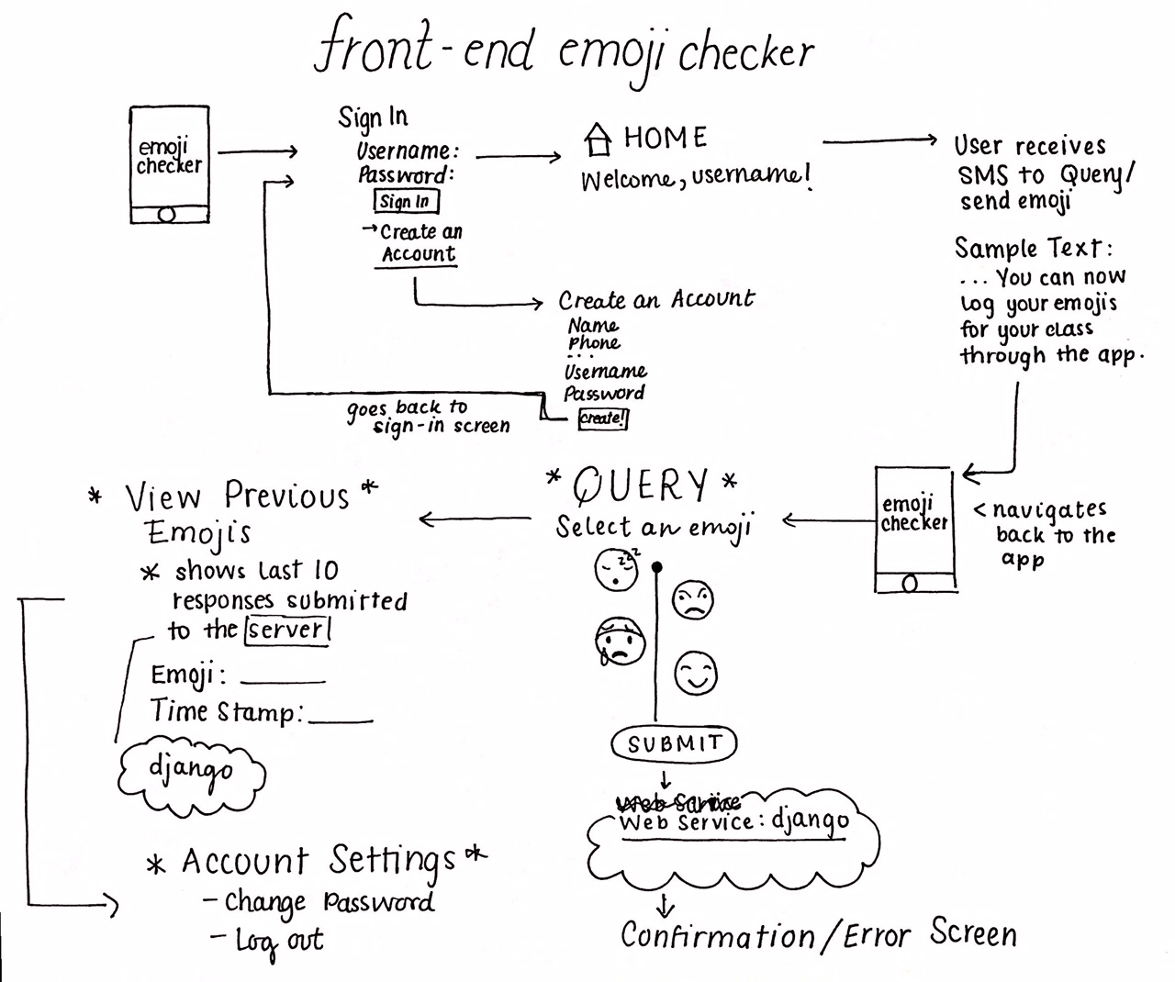
Conceptual Models
Original
NEW*

Slide 7

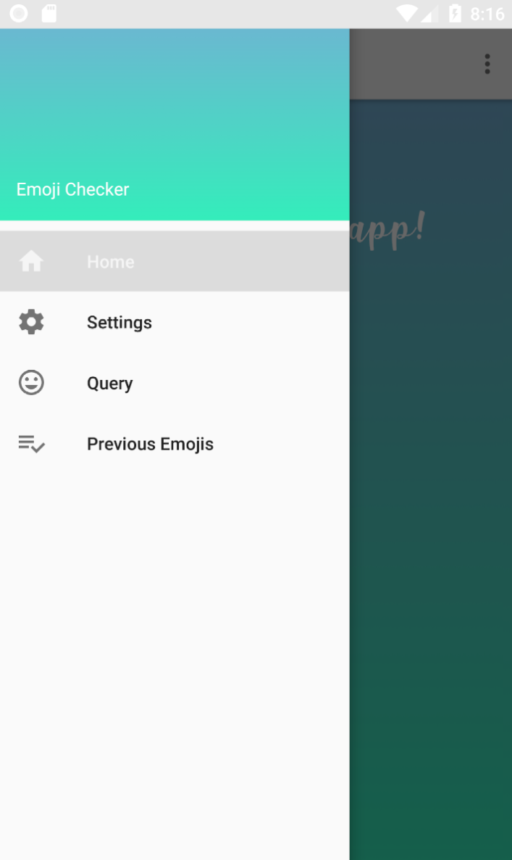
Future Improvements
Login Screen
Add error messages for invalid password
Add “Forgot Password” feature
Account Settings
Enable change phone number functionality
Personalize with profile pic/emoji
JUnit Testing
Home Page
Add reminders about upcoming tests/quizzes

